Slide 1
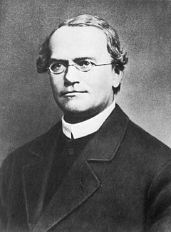
Mendelian classic disorders: sex-linked inheritance

Slide 2
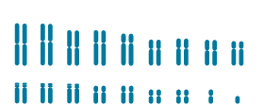
Mendelian classic disorders: sex-linked inheritance
Mendelian inheritance follows Mendel’s laws
There are 23 pairs of chromosomes in a human. 22 of the autosomal chromosomes, and 1 pair is sex chromosomes. Autosomal inheritance means that the observed trait is located on an autosomal chromosome.
Sex chromosomes

Slide 3
Mendelian inheritance patterns:
autosomal dominant
X-linked recessive
disease locus is present on an autosome (any chromosome other than X or Y), and so an affected person can be of either sex.
Examples: Marfan syndrome, Achondroplasia, Hypertrychosis
affected individuals are mostly male, and affected males are usually born to unaffected parents. The mother of an affected male is quite often a carrier
Color blindness, Hemophilia, Ichtiosis, Lesch–Nyhan syndrome, Duchenne Muscular Dystrophy
X-linked dominant
autosomal recessive
As in autosomal dominant disorders, affected individuals with an X-linked dominant disorder can be of either sex, and usually at least one parent is affected. However, there are significantly more affected females than affected males
Vitamin-resistant rickets
Affected individuals carry two mutant alleles at the disease locus, usually born to unaffected parents who are heterozygotes carriers
Consanguinity increases the risks of AR disorders
Examples: Sickle cell anemia, Cystic fibrosis, phenylketonuria, galactosemia, alkaptonuria, fructosuria, Wilson Konovalov disease
]
Y-linked
males only should be affected and there should be exclusive male-to-male transmission.
Example: hairy ears

Slide 4
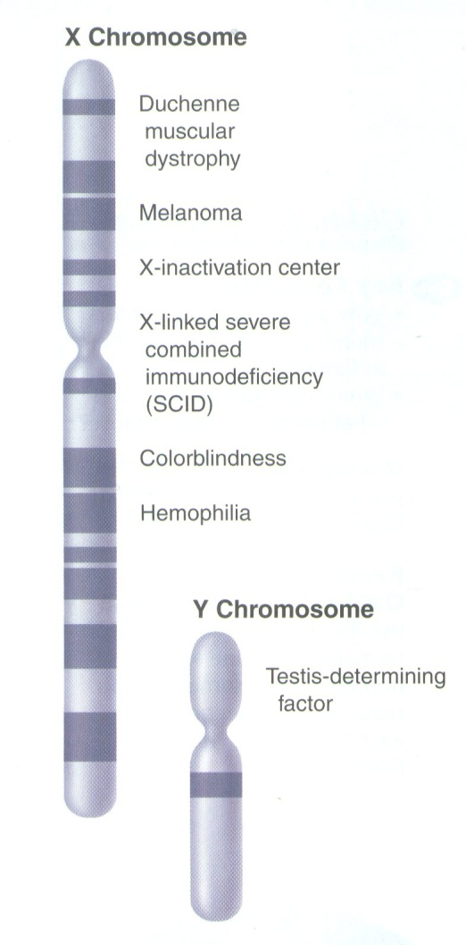
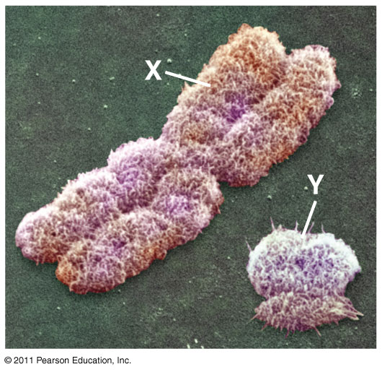
Sex-linked genes
Sex-linked gene on X or Y
Females (XX), male (XY)
Eggs = X, sperm = X or Y
Fathers pass X-linked genes to daughters, but not sons
Males express recessive trait on the single X (hemizygous)
Females can be affected or carrier

Slide 5
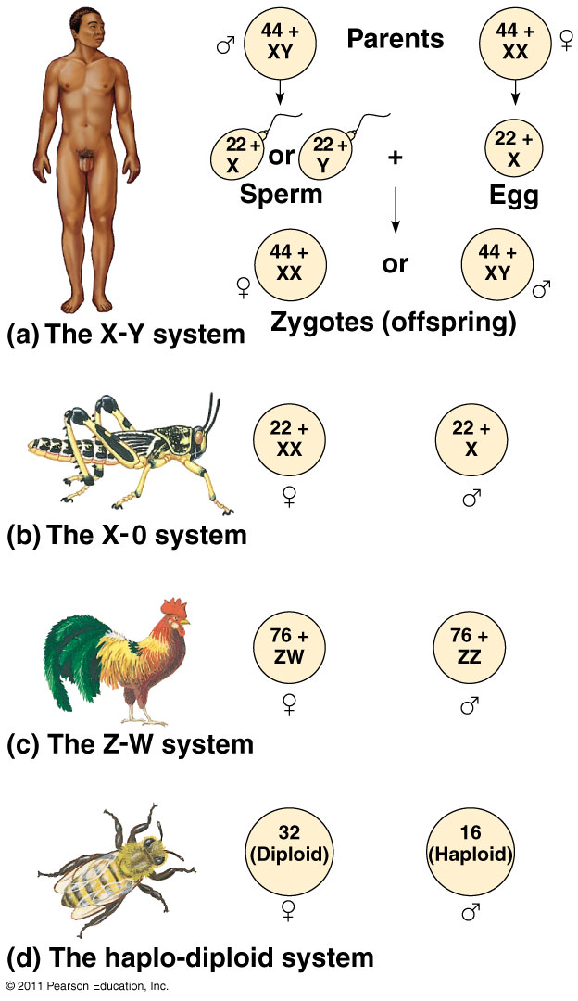
Sex determination varies in animals

Slide 6
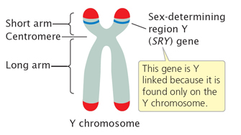
Human development
The X and Y are very different in size, organization, and gene content
Y chromosome contains only 70 to 200 genes, while X chromosome contains 900 to 1,400.
Y chromosome required for development of testes
SRY gene: sex-determining region of Y
Genes on Y chromosome code for proteins that regulates male characters

Slide 7
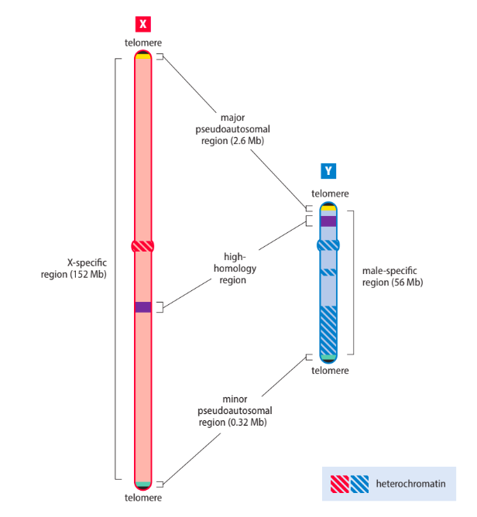
Pseudoautosomal and Y-linked inheritance
The pseudoautosomal regions are the only regions of the X and Y that can pair up during male meiosis and undergo recombination.
They are located just before the telomere-associated repeats at the ends of both the short and long chromosome arms
the Y-specific region is never involved in recombination and so is also called the male-specific region.
The complement of genes on the X-chromosome has been quite stable in evolution, because there is little opportunity for meiotic exchange with the Y-chromosome.
There are few genes in the pseudoautosomal regions, mutations in KAL can cause Kallmann syndrome (PMID 20301509), and the SHOX homeobox gene is a locus for Leri–Weill dyschondreostosis (OMIM 127300) and Langer mesomelic dysplasia (OMIM 249700).

Slide 8
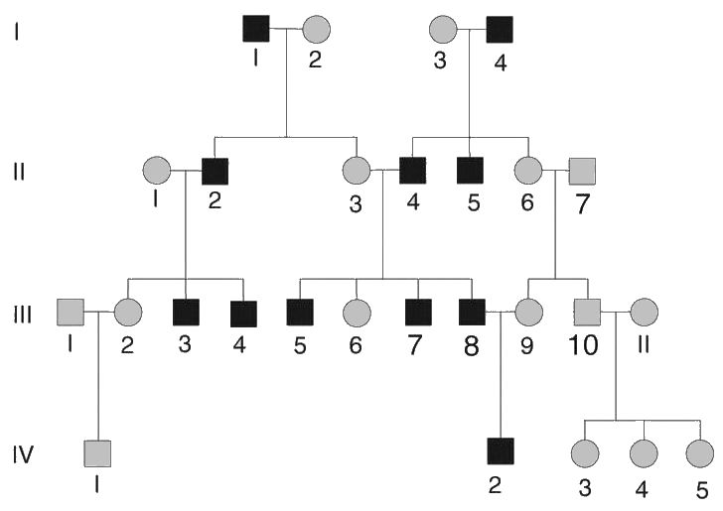
Y-linked inheritance
exclusive male-to-male transmission
because of the lack of genes, Y-linked disorders are rare
Y-linked traits: hairy ears (OMIM 425500), maleness

Slide 9
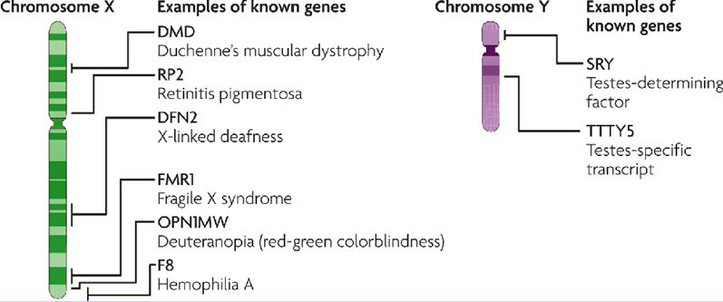
X-linked patterns of inheritance
X-linked recessive
X-linked dominant
Male surviving
Either sex affected, males more severely than females
Male lethal
Only females seen with disease, mosaic patterns of expression
Primarily males affected
Females typically unaffected, but there are exceptions

Slide 10
X-linked recessive
affected individuals are mostly male, and affected males are usually born to unaffected parents.
The mother of an affected male is quite often a carrier
There is no male-to-male transmission because males pass a Y chromosome to sons
A pedigree may appear to show male-to-male transmission when an affected man and a carrier woman produce an affected son
The same parents could potentially transmit a mutant X to produce an affected daughter.
female carriers with a single mutant allele can occasionally be quite severely affected and are known as manifesting heterozygotes.

Slide 11
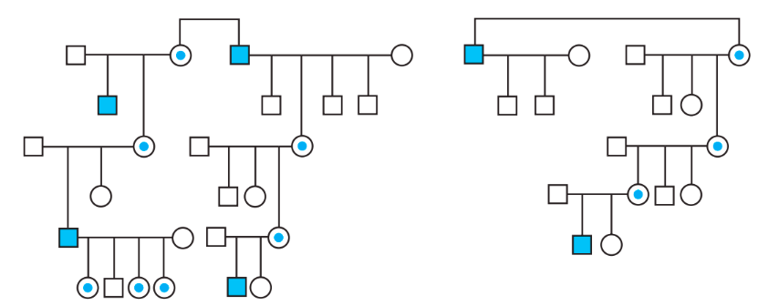
X-linked recessive
Transmission of genes on the X-chromosome follows a pattern that has been called diagonal
All males with the mutation will be affected.
Male-to-male transmission is impossible because a father must give his Y-chromosome to any son.
All daughters of an affected man must be carriers (indicated by the dot within the circle as shown).
The frequency of the phenotype in males is the same as the frequency of the mutant allele.

Slide 12
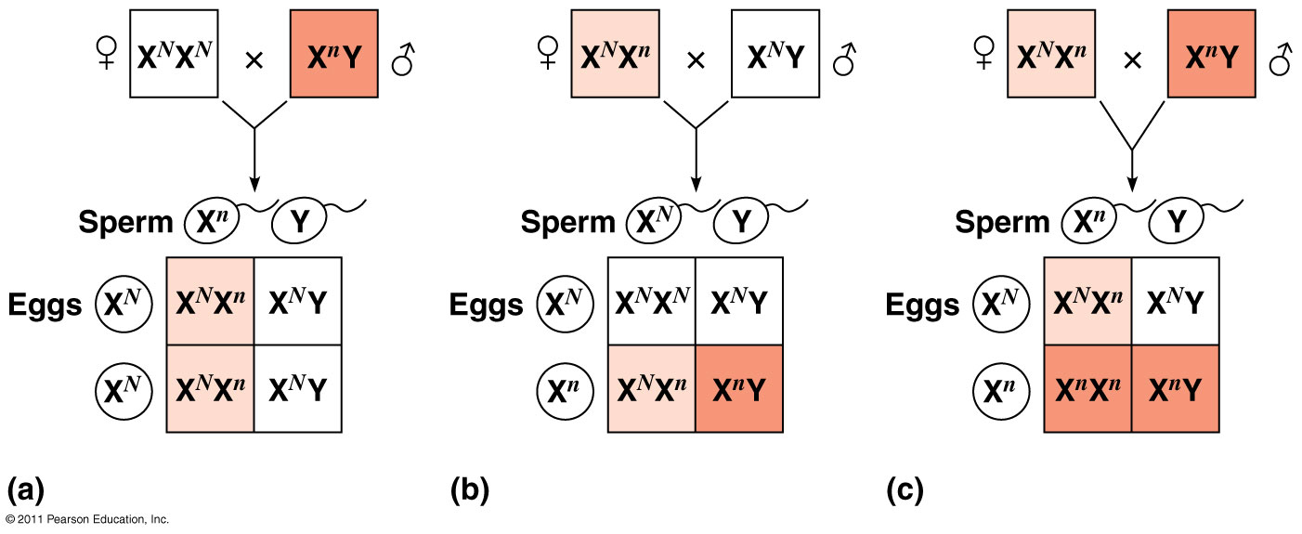
Transmission of sex-linked recessive traits

Slide 13
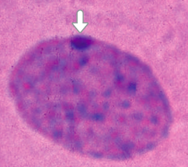
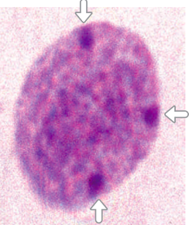
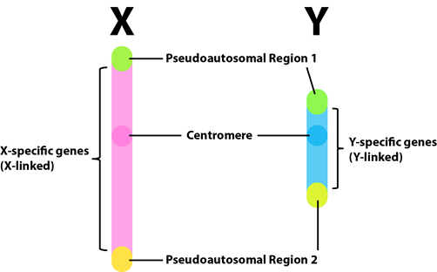
X-Inactivation
Images courtesy of Malcolm Ferguson-Smith.
Gene dosage must be controlled in a cell. Extra or lack of chromosomes are harmful and causes different syndromes. To compensate for having different numbers of X chromosomes in males and females, a special mechanism is needed to silence genes on one of the two X chromosomes in each female cell.
Barr body = inactive X chromosome; regulate gene dosage in females during embryonic development
A cell from an XX female has a single inactivated X chromosome
that forms a Barr body (arrow).
A cell from a 49,XXXXY male has one active X chromosome plus three inactivated X chromosomes that form Barr bodies (arrows).
Note that some genes, including genes in the pseudoautosomal regions, escape inactivation.

Slide 14
The female carrier
If the number of X chromosomes is two (or more), all except one of the multiple X chromosomes is inactivated.
Because of random X-chromosome inactivation (Lyonization) expression of the mutation in females can vary from prominent (uncommon) to absent depending on the gene involved and the assay used.
Symptomatic individuals often are referred to as manifesting heterozygotes.
Detecting carrier status is important for genetic counseling.

Slide 15
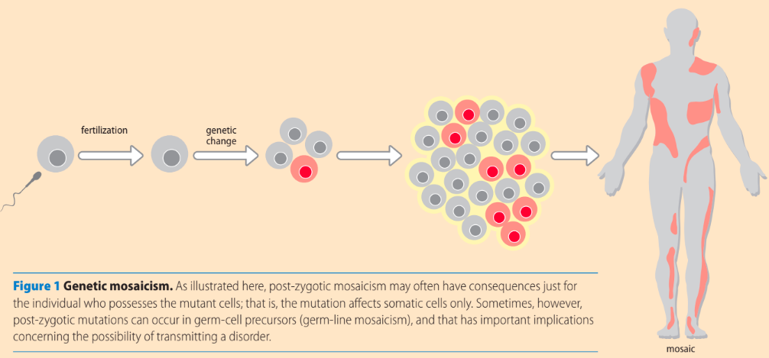
Genetic mosaicism
Post-zygotic mosaicism may often have consequences just for the individual who possesses the mutant cells; that is, the mutation affects somatic cells only. Sometimes, however, post-zygotic mutations can occur in germ-cell precursors (germ-line mosaicism), and that has important implications concerning the possibility of transmitting a disorder.

Slide 16
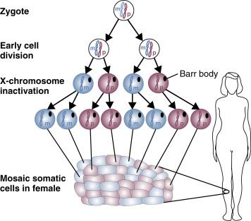
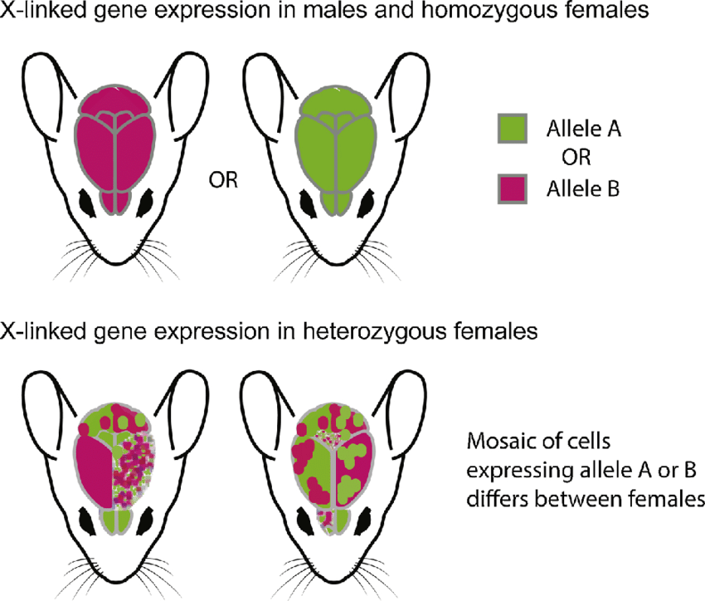
Mosaic female
In humans the initial decision to inactivate one of the two X chromosomes is randomly made in the preimplantation embryo, beginning at around the eight-cell stage; some cells inactivate the paternal X and the remainder inactivate the maternal X. Once a cell has chosen which X to inactivate in the early embryo, that pattern of X-inactivation is continued in all descendant cells.
Thus, a female who is heterozygous at a disease locus will be a genetic mosaic, containing cell clones in which the normal allele is expressed and clones in which the mutant allele is expressed. As described below, this has implications for the female phenotype in X-linked disorders.

Slide 17
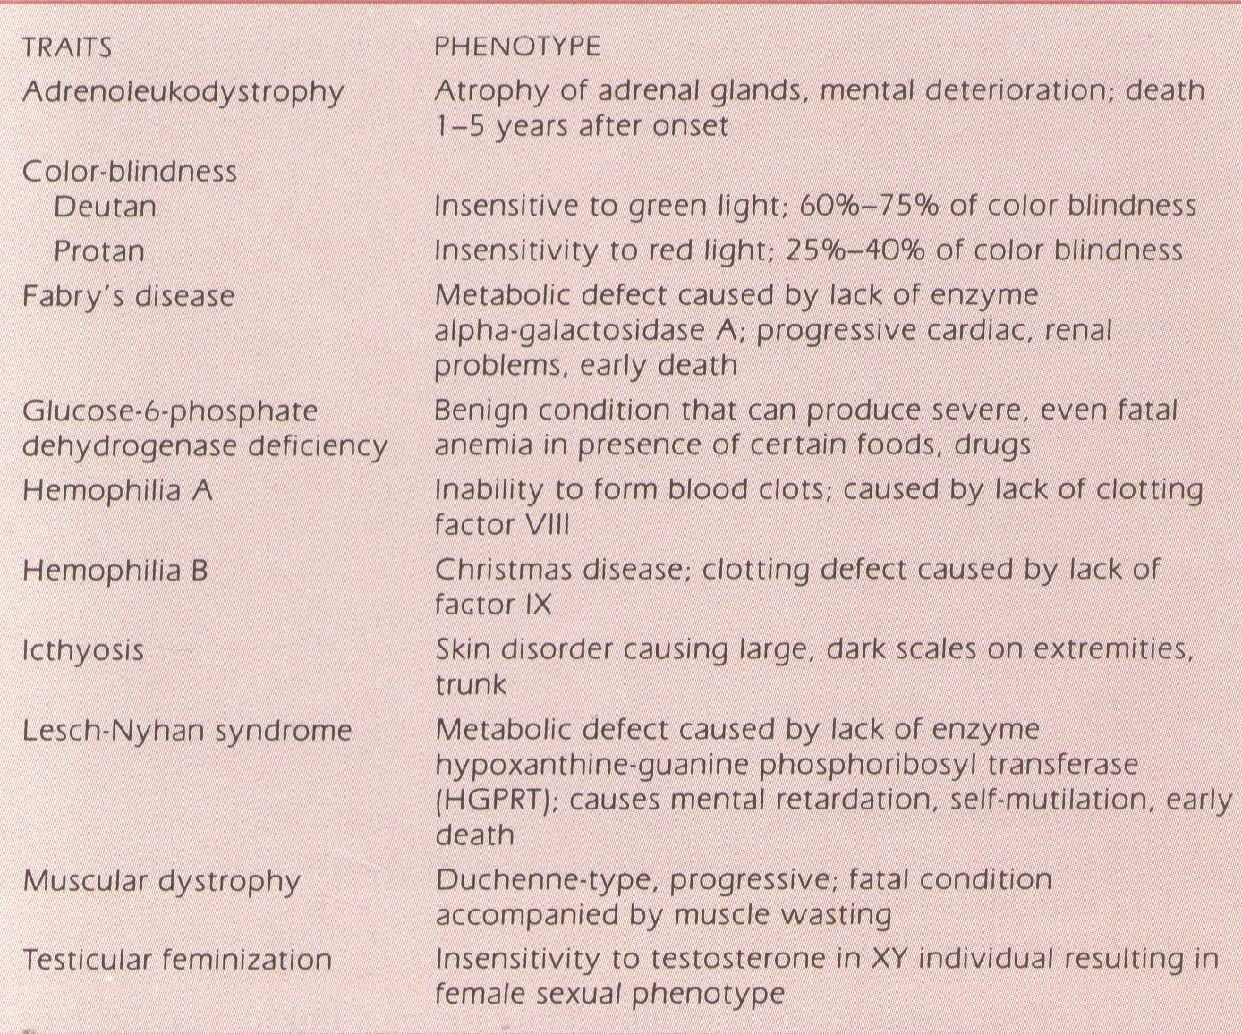
Sex-linked disorders

Slide 18
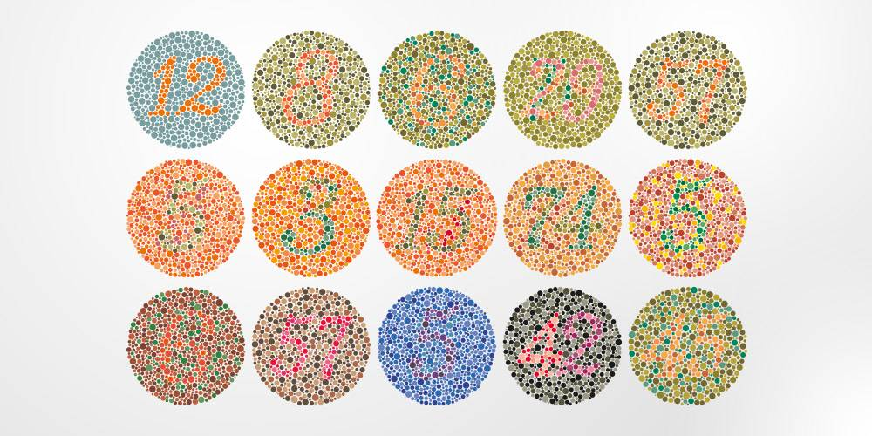
Colour blindness test
Who is more likely to have color blindness mare or female? Why?

Slide 19
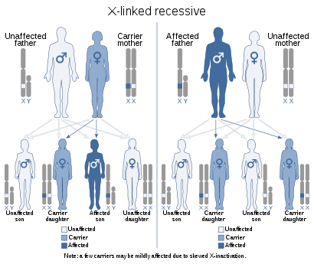
Colour blindness
Males have 1 X chromosome and 1 Y chromosome, and females have 2 X chromosomes. The genes that can give you red-green color blindness are passed down on the X chromosome. Since it's passed down on the X chromosome, red-green color blindness is more common in men.
● Xq28
● There is a problem with the pigments in certain nerve cells of the eye that sense color. These cells are called cones. They are found in the light-sensitive layer of tissue at the back of the eye, called the retina.
● Symptoms: trouble seeing
The difference between colors
How bright colors are
Different shades of colors

Slide 20
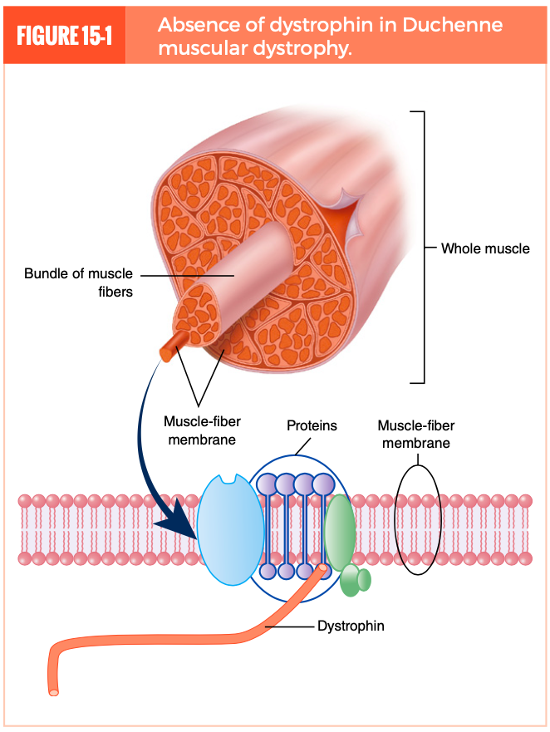
Duchenne muscular dystrophy
Muscular dystrophy (MD) is a group of more than 30 genetically inherited diseases that are characterized by progressive muscle atrophy
The condition of MD is caused by a gene mutation that affects the production of muscle proteins needed to build healthy muscle tissue
The two most common types are Duchenne muscular dystrophy (DMD) and Becker muscular dystrophy (BMD).
The absence of dystrophin (dystrophinopathies) in Duchenne muscular dystrophy causes the muscle tissue to lack integrity
Duchenne muscular dystrophy is the most common childhood form of the disease; it occurs in one of every 3,300 male births. It is a sex-linked disorder, meaning that it strikes males almost exclusively.

Slide 21
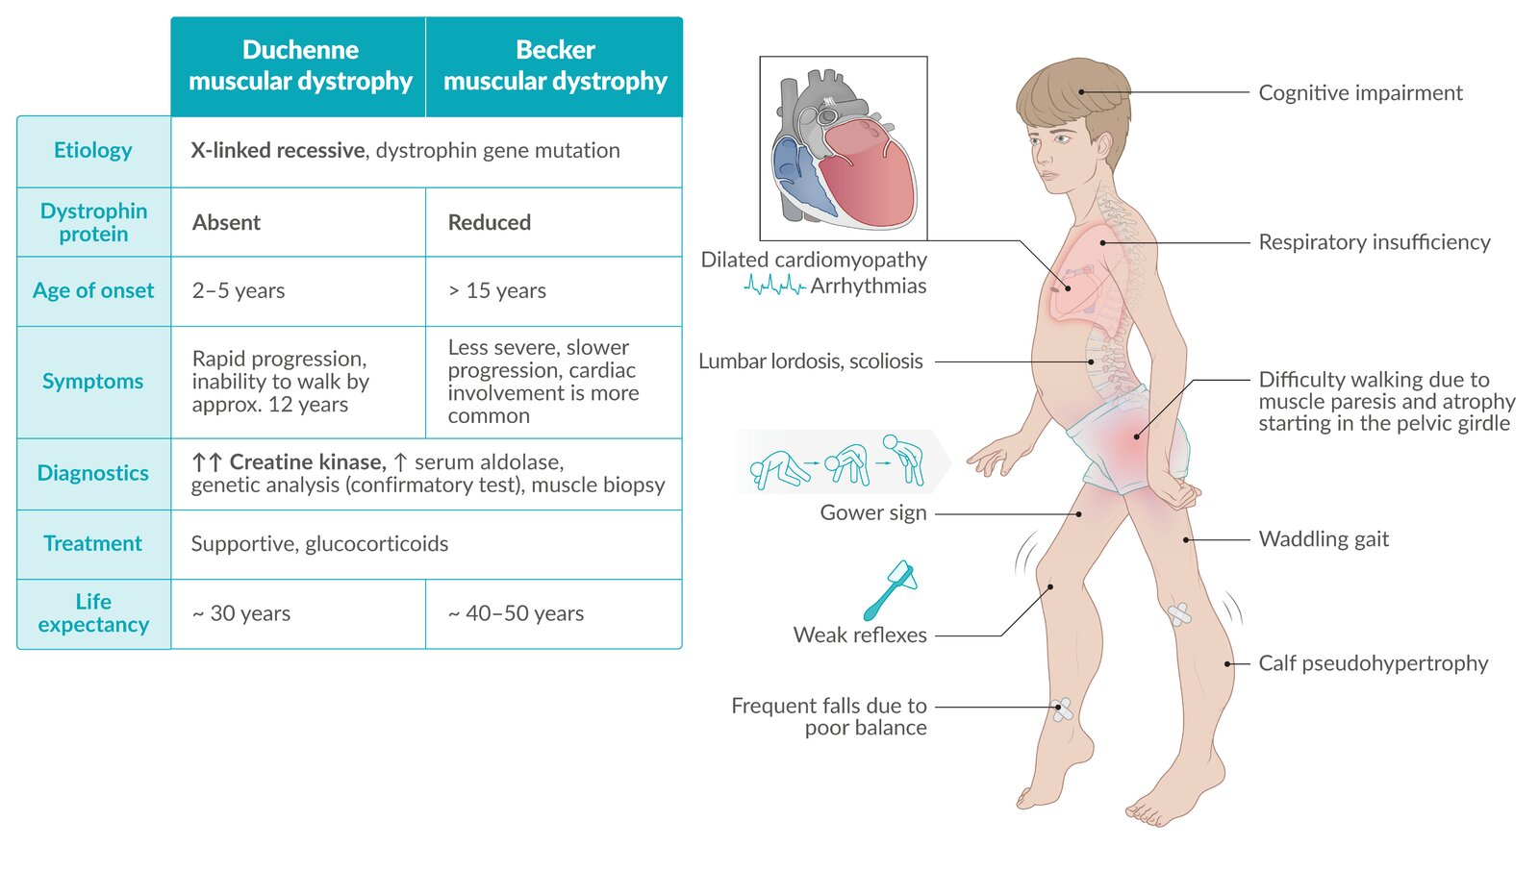
DMD is inherited in an X-linked recessive pattern
Together, DMD and BMD affect 1 in 3,500 to 5,000 newborn males world- wide. In the United States, between 400 and 600 boys are born with these conditions each year

Slide 22
Hemophilia
 | Hemophilia A (Xq28, OMIM 306700) | Hemophilia B
Definition | a bleeding disorder in which a specific clotting factor protein is missing or does not function normally.
 | “classic” hemophilia | “Christmas disease”
gene | F8 gene | F9 gene
Clotting factor | factor VIII deficiency | factor IX deficiency
Frequency | 1 in 4,000 males | 1 in 20,000 males
Symptoms | spontaneous bleeding into the joints (hemarthroses), bleeding into muscles, and variable degrees of prolonged or abnormal bleeding in other soft tissues, a collection of blood under the skull due to an effusion of blood, usually as a result of trauma (cephalohematoma). Postoperative and traumatic bleeding. Unexplained gastrointestinal or genitourinary bleeding may also occur. Prolonged nosebleeds that are recurrent over time, are bilateral, and are not elicited by trauma are often present. Prolonged oozing or bleeding after initial cessation of bleeding due to tooth extraction, buccal mucosa injury, or circumcision is also common.
Diagnosis | specific factor assays, which test for the levels of the suspected deficient factor. Coagulation screening consisting of an APTT measurement, a PT measurement, a bleeding time measurement, fibrinogen levels, and a platelet count
Treatment | treatment is needed to help their blood clot and stop the bleeding. This usually involves giving clotting factors by infusion or injection.

Slide 23
Complete Blood Count (CBC)
This common test measures the amount of hemoglobin (the red pigment inside red blood cells that carries oxygen), the size and number of red blood cells and numbers of different types of white blood cells and platelets found in blood. The CBC is normal in people with hemophilia. However, if a person with hemophilia has unusually heavy bleeding or bleeds for a long time, the hemoglobin and the red blood cell count can be low.
Activated Partial Thromboplastin Time (APTT) Test
This test measures how long it takes for blood to clot. It measures the clotting ability of factors VIII (8), IX (9), XI (11), and XII (12). If any of these clotting factors are too low, it takes longer than normal for the blood to clot. The results of this test will show a longer clotting time among people with hemophilia A or B.
Prothrombin Time (PT) Test
This test also measures the time it takes for blood to clot. It measures primarily the clotting ability of factors I (1), II (2), V (5), VII (7), and X (10). If any of these factors are too low, it takes longer than normal for the blood to clot. The results of this test will be normal among most people with hemophilia A and B.
Fibrinogen Test
This test also helps doctors assess a patient’s ability to form a blood clot. Fibrinogen is another name for clotting factor I.

Slide 24
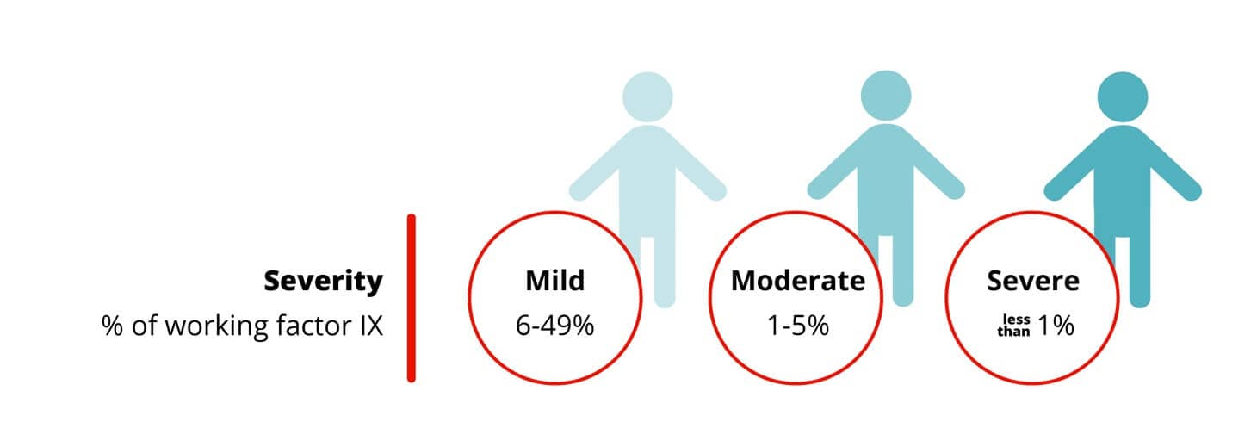
Clotting factor test shows the type of hemophilia and the severity. It is important to know the type and severity in order to create the best treatment plan.
Severity | Clotting factor level % activity (IU/ml) | Symptoms | Usual age of diagnosis
severe hemophilia | <1% | heavy bleeding can occur without any obvious trauma—spontaneous bleeding, bleeding into the weight-bearing joints (hemarthroses) and muscles and into the brain (cephalohematoma) or internal organs, propensity for excessive bleeding during menses (menorrhagia). | Shortly after birth
Moderate hemophilia | 1-5% | may also present with hemarthroses or deep-tissue hematomas due to minor trauma or as postoperative bleeding | Before age 5-6
 | 6-49% | does not involve spontaneous bleeding and may become apparent only when abnormal bleeding occurs following surgery or a serious injury. | Often later in life

Slide 25
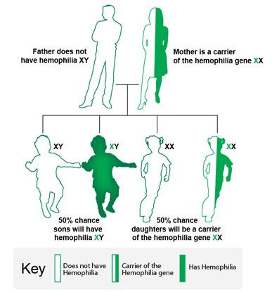
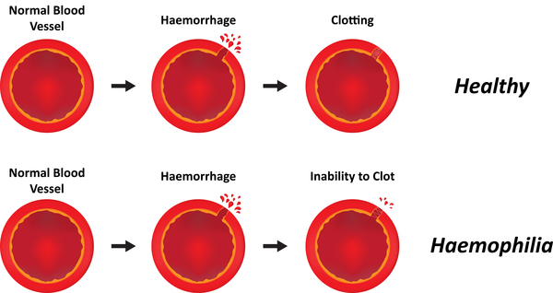
How hemophilia is inherited?
In this example, the mother is a carrier of the hemophilia gene, and the father does not have hemophilia.
There is a 50% chance that each son will have hemophilia.
There is a 50% chance that each daughter will be a carrier of the hemophilia gene.

Slide 26
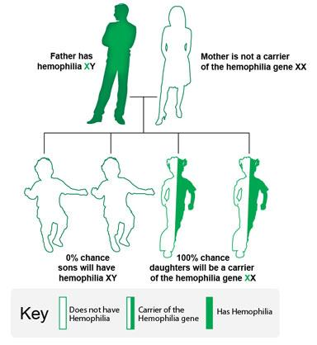
In this example, the father has hemophilia, and the mother does not carry the hemophilia gene.
1. All daughters will carry the hemophilia gene.
No sons will have hemophilia.

Slide 27
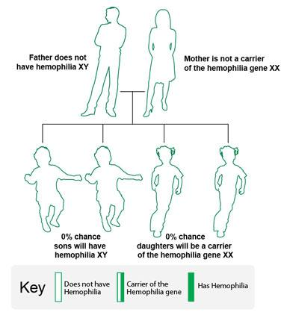
In this example, the father does not have hemophilia, and the mother does not carry the hemophilia gene.
1.None of the children (daughters or sons) will have hemophilia or carry the gene.
It is important to note that in one-third of people with hemophilia, there is no family history of the disorder.

Slide 28
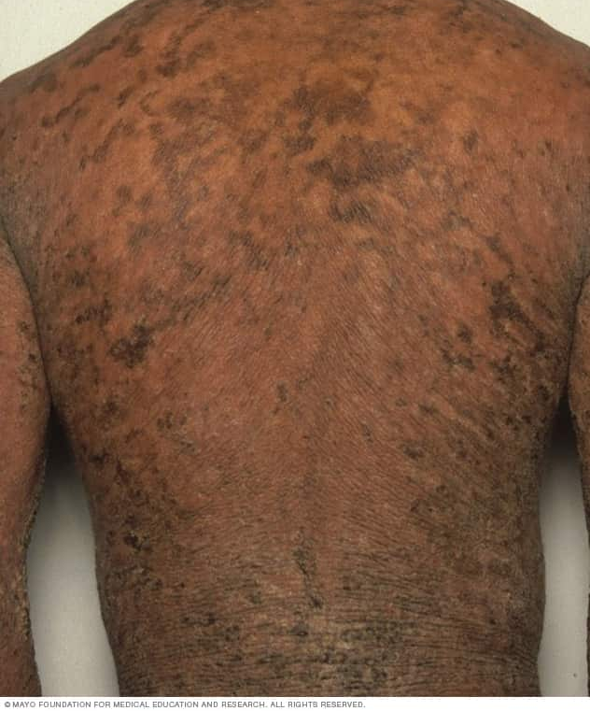

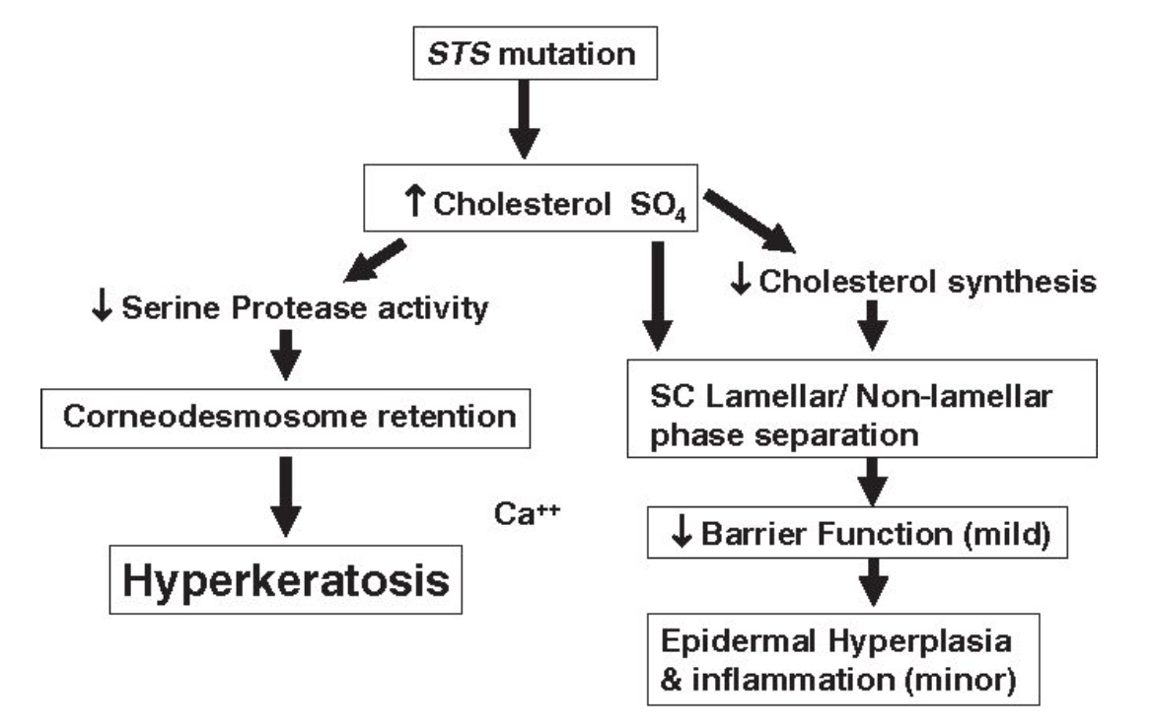
Ichtyosis
Results from steroid sulfatase deficiency, is caused by mutation or deletion of the STS gene on chromosome Xp22. Most patients (90%) have deletions of the STS gene.
Clinically characterized by widespread, dark brown, polygonal scales and generalized dryness. Cutaneous manifestations are present soon after birth and usually do not improve with age. The histopathology of XLI typically shows compact hyperkeratosis and slight acanthosis with a normal granular layer.
Frequency: 1 in 3,000

Slide 29
Treatment
Medicines containing lactic acid or alpha hydroxy acids can help the skin to maintain moisture and prevent scaling
Apply moisturiser or cream containing urea to keep the skin hydrated
Avoid going out in hot and humid temperature
Retinoids medicines to slow down the over production of skin cells
Avoid scratching the affected area
If ichtyosis is left untreated it will cause excessive dryness of skin. Dry skin is vulnerable to severe skin infections like atopic dermatitis

Slide 30
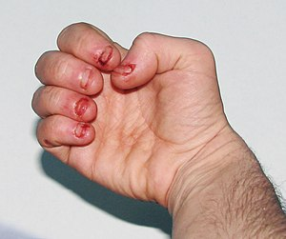
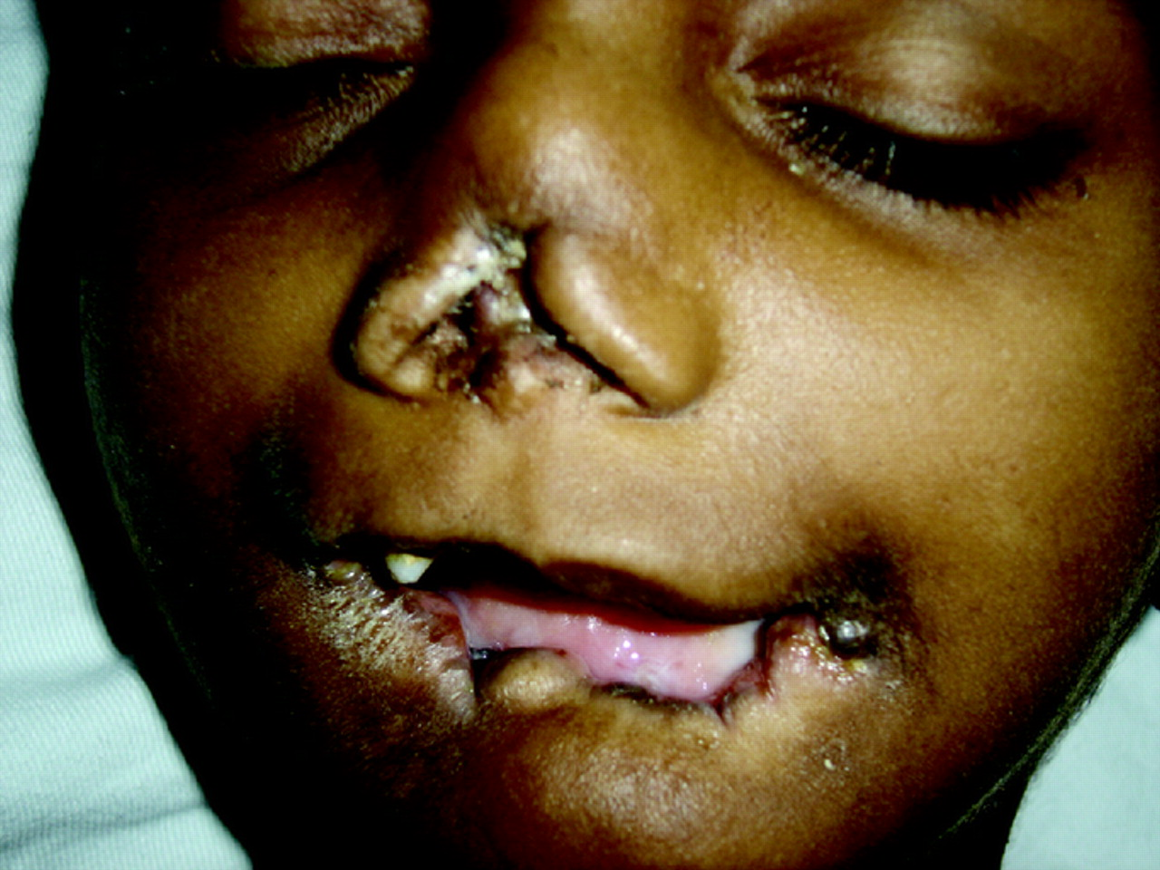
Lesch–Nyhan syndrome
Definition | Lesch-Nyhan syndrome (LNS) is a rare, inherited disorder caused by a deficiency of the enzyme hypoxanthine-guanine phosphoribosyltransferase (HPRT).
gene | HPRT1 gene
Inheritance | X-linked recessive disease
Frequency | 1 in 380,000 individuals
Symptoms | impaired kidney function, acute gouty arthritis, and self-mutilating behaviors such as lip and finger biting and/or head banging, involuntary muscle movements, and neurological impairment, mental retardation, seizures, microcephaly
Diagnosis | clinical evaluation, including a detailed patient history and specialized blood tests which shows abnormally high concentrations of uric acid in the blood
Treatment | Gout can be treated with allopurinol to control excessive amounts of uric acid. Kidney stones may be treated with lithotripsy, neurological symptoms may be relieved with the drugs carbidopa/levodopa, diazepam, phenobarbital, or haloperidol.

Slide 31
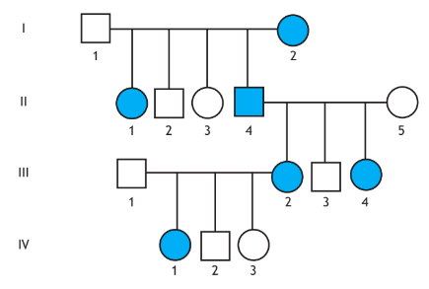
X-linked dominant
Both males and females are affected and able to transmit the trait
usually at least one parent is affected.
there are significantly more affected females than affected males
Females transmit the trait to 50% of both sons and daughters.
Males transmit to all daughters and no sons.
The milder phenotype seen in affected females as a result of X-inactivation

Slide 32
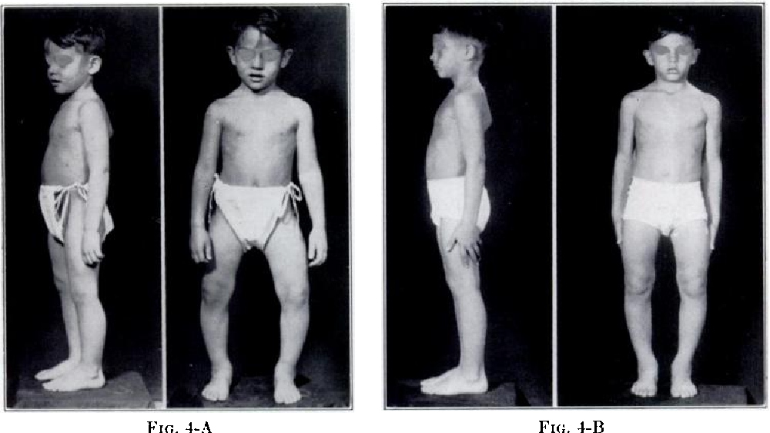
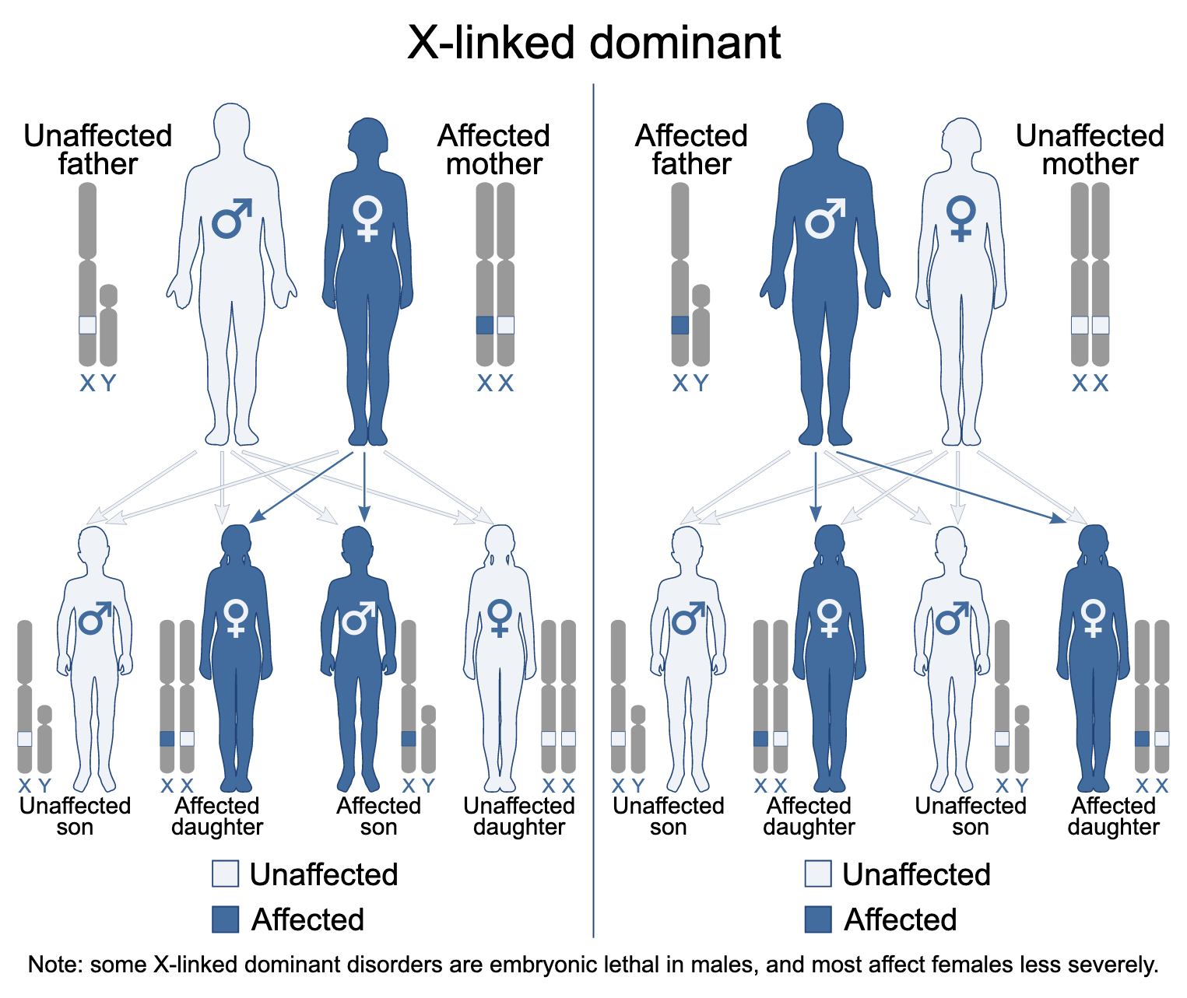
Vitamin-resistant rickets
Definition | a disorder in which the bones become painfully soft and bend easily, due to low levels of phosphate in the blood.
gene | vitamin D receptor (VDR)
Inheritance | X-linked dominant disease
Frequency | 1 in 200,000 children
Symptoms | bone deformities and bone pain, slow growth, fractures and seizures
Diagnosis | serum phosphate, alkaline phosphatase, and 1,25-dihydroxyvitamin D3 levels
Treatment | vitamin D supplementation and with additional calcium supplementation. Careful observation of patients during vitamin D therapy to prevent overdosage and resultant hypercalcemia is of utmost importance. Surgical correction of the bony deformities is rarely necessary.

Slide 33
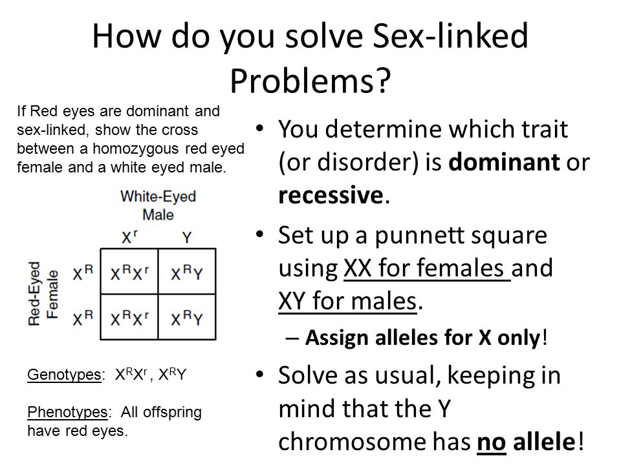
How to solve X-linked problems?

Slide 34
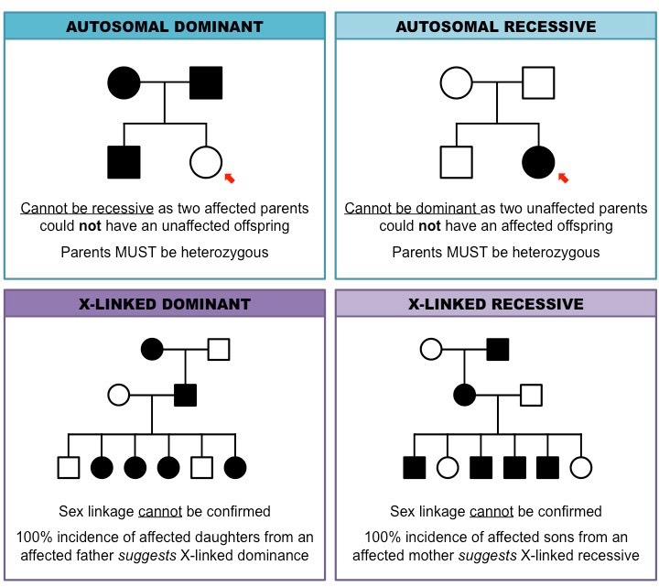
Interpretation of pedigrees
Autosomal dominant disorder occur in both males and females, often affecting many individuals throughout the pedigree. Inheritance of one copy of the gene is sufficient to cause disease. The risk of transmission of such a condition from affected individuals is 50%. This is the most common pattern of inheritance observed for mendelian disorders
Autosomal recessive mode of inheritance occurs when two healthy individuals are carriers of the same recessive gene. Most AR genes are rare, and carriers usually will have no family history. The conditions often only occur within the children from one relationship. The risk of the transmission of the disorder is 25% and half of the unaffected offspring will be carriers for the gene. Consanguinity (relatedness between parents) is a risk factor for autosomal recessive illness because both parents are more likely to carry the same rare recessive alleles, inherited from a common ancestor. All individuals probably carry a large number of rare recessive alleles as a result of the natural genetic diversity present within the human population
X linked recessive conditions mostly occur in males. Females are carriers, because their second X chromosome provides a normal allele, but males who inherit the recessive gene on their X-chromosome will be affected. Occasionally, females will show a degree of affectedness. Female carriers will transmit the gene to half of their sons and to half of their daughters. Affected males will transmit the gene to all their daughters all of whom will therefore be carriers. Sons of affected males receive only their Y chromosome from father

